Slide 1

University of NewHaven Tagliatela college of Engineering Distributed and Scalable Engineering Class DSCI-6007-03 Spring-2023
HEART DISEASE PREDICTION

Slide 2
Team Working on it
Sravan Kumar Reddy Pebbeti (Data Analyst)
Rakshala mukka (Data Engineer)
Keerthana Krishnamoorthy (Machine Learning Engineer)
Svachuta Siva Sai Krishna Prasad Gollavilli (Lead Data Scientist)

Slide 3
Motivation
Cardiovascular disease is the leading cause of death in several countries. Doctors typically diagnose this illness by analyzing recent clinical tests and drawing on their past experience treating patients with similar symptoms. Swift diagnosis, immediate treatment, and continuous monitoring are critical for patients with heart disease. To address these needs, various data mining techniques have been employed in the past to diagnose and forecast heart disease. However, earlier research did not give enough attention to determining the effectiveness of these techniques, focusing instead on identifying the primary factors contributing to heart disease prediction.

Slide 4
Problem Statement
Problem Statement
The effective management of heart disease involves a combination of lifestyle changes, medication, and, in certain situations, surgery. Appropriate treatment can help reduce symptoms and improve heart function, potentially preventing the need for costly surgical interventions. Our goal is to accurately predict the presence of heart disease with minimal testing and a limited set of attributes. While many more input attributes could be considered, we prioritize efficiency and accuracy in our predictions. Unfortunately, medical decisions are often made based on doctors' intuition rather than the valuable data available in our datasets and databases. This practice can result in biases, errors, and unnecessary expenses that compromise patient care quality.

Slide 5
Business Understanding
Business Understanding
By implementing this, we can add this project to smart watch or as mobile app which will help everyone to get to know the risk of heart disease.

Slide 6
Methodology
In this project, we used data modeling to develop the most effective way to locate the results based on the accuracy rates of our three algorithms: decision trees, logistic regression, and random forest classification. The best model for predicting the patient's heart illness is the one with the highest accuracy rate.
To assess the precision of our model, we used train and test methodologies. As we divided the data into two sets, 80% of the data was used for training and 20% was used for testing. Therefore, we used a training set to train our model and a testing set to test it.

Slide 7
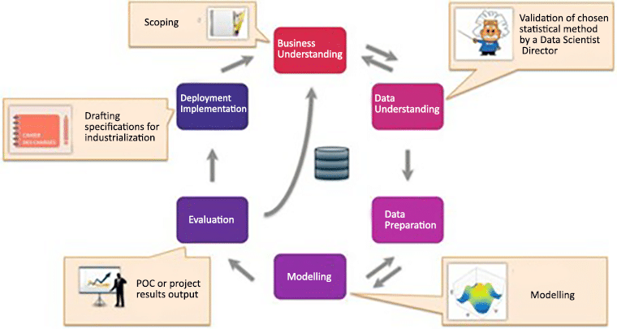
CRISP-DM: Six Phases of Data Mining

Slide 8
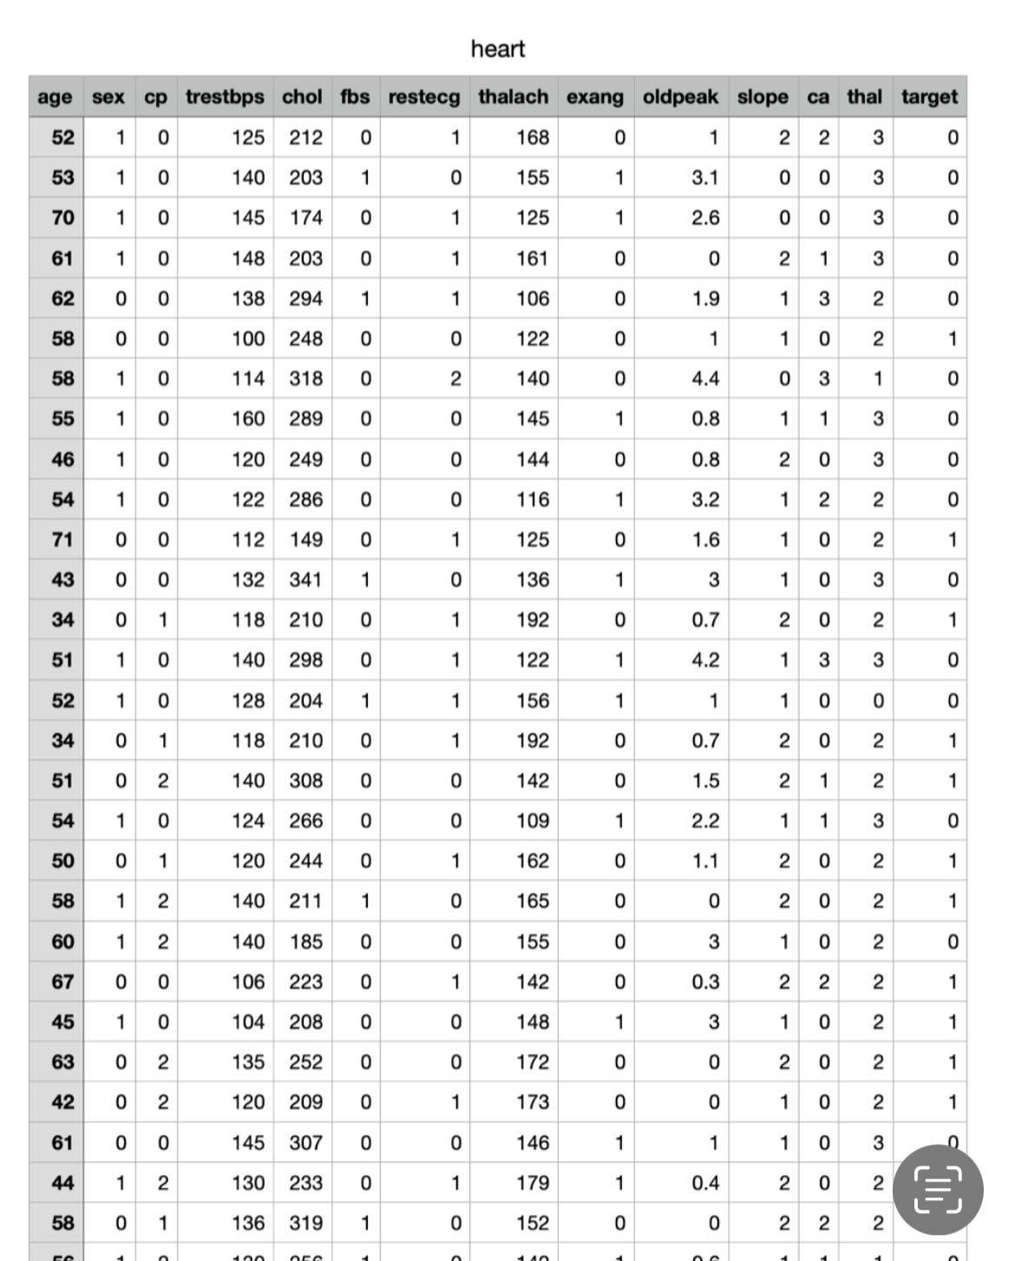
Data Collection
We have collected the data by the process of gathering and measuring information on targeted variables of interest in an organized system, which then allowed us to answer relevant questions and decide future outcomes. We made sure your data is Relevant and Validated. We choose our source site as Kaggle as it provides the quality and valid data.

Slide 9
Data Understanding
We have imported the data from the data set using different libraries like numpy, pandas, matplotlib and seaborn. After loading the data, we read the dataset. These are the parts of the data loading. Our dataset consists of fourteen columns which are
Age: patient’s age
Sex: Gender of the patient (Male = 1, Female = 0),
Chest pain type(CP): Includes pressure, fullness, burning or tightness in the chest .
Trestbps: A person’s resting blood pressure >120.
Chol: cholesterol levels. Good = less than 200, Moderate = 200-239, High = >240.
Fasting blood sugar(FBS): Measures the blood sugar after the overnight fast. 0 = normal, 1 = abnormal.
Resting electro cartographic results(rest ECG): Normal heart rate beats 60-100 per minute. 0 = normal, 1 = abnormal.
Thalach: Persons maximum heart rate achieved.
Exercise included angina(exang): The pain or stress that occurs after exercise. 0 = normal, 1 = abnormal.
Oldpeak: Exercise relative to rest. Records the slope of the peak exercise whether up, flat or down. Ranges between 0 to 5.
Slope: It is ST segment shift relative to the exercise-induced increments in patients heart rate.
CA: Coronary artery disease. Patients records of having CA. 0 no records, 1 or 2 had the cardiac attacks in the past.
Thal: A blood disorder called thalassemia.
Target.
By providing all the fields required we can predict whether the patient has the heart related diseases or not. If our end result is the integer valued 0 then that particular patient has no heartdisease and if the result is integer 1 then the patient has heart disease. We used info, dtypes, shape, describe to understand our dataset.

Slide 10
Data Preparation
We performed EDA to find any underlying patterns within the data, detect outliers and test assumptions with the final aim of finding a model that fits our data well. There are four main types of EDA in general which are Univariate non-graphical, Univariate graphical, Multivariate non-graphical and Multivariate graphical.
Univariate non-graphical: make observations of the population and understand sample distributions of a single variable. (e.g. the measure of spread, the measure of central tendency, outlier detection) Univariate graphical: graphical analysis on a single variable. (e.g. Histograms, Boxplots, Stemand leaf)
Multivariate non-graphical: techniques which show the relationship between two or more variables. (e.g. covariance, correlations)
Multivariate graphical: graphically show the relationship between two or more variables. (e.g. bar plots, scatterplots)

Slide 11
Decision Tree
Decision Tree belongs to the family of supervised learning algorithms. Unlike other supervised learning algorithms, the decision tree algorithm can be used for solving regression and classification problems too.
The goal of using a Decision Tree is to create a training model that can use to predict the class or value of the target variable by learning simple decision rules inferred from prior data(training data).
In Decision Trees, for predicting a class label for a record we start from the root of the tree. We compare the values of the root attribute with the record’s attribute. On the basis of comparison, we follow the branch corresponding to that value and jump to the next node.

Slide 12
Logistic regression
Logistic regression is used to describe data and to explain the relationship between one dependent binary variable and one or more nominal, ordinal, interval or ratio-level independent variables.

Slide 13
Random Forest classification
Random forest is a technique used in modeling predictions and behavior analysis and is built on decision trees. It contains many decision trees representing a distinct instance of the classification of data input into the random forest. The random forest technique considers the instances individually, taking the one with the majority of votes as the selected prediction.

Slide 14
End Results
After deploying and saving our model we will test the end results on a test dataset. We divided into two classifiers 1 the patient has heart disease, 0 meaning the patient has no heart disease. We have all the fourteen fields in the dataset with some patient records.

Slide 15
Thank You

